Slide 1
STUFF COMPLETED Thus Far
GITHUB

Slide 2
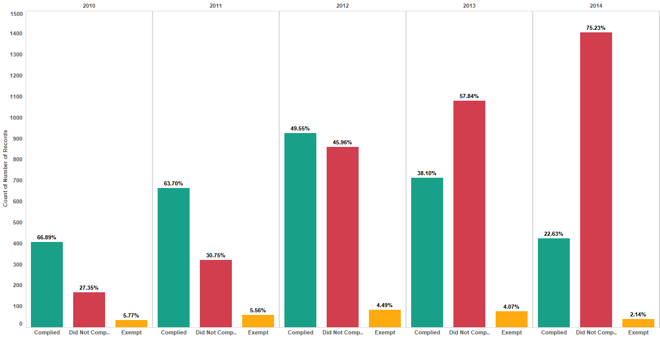

COMPLIANCE Building Count Y/Y

Slide 3
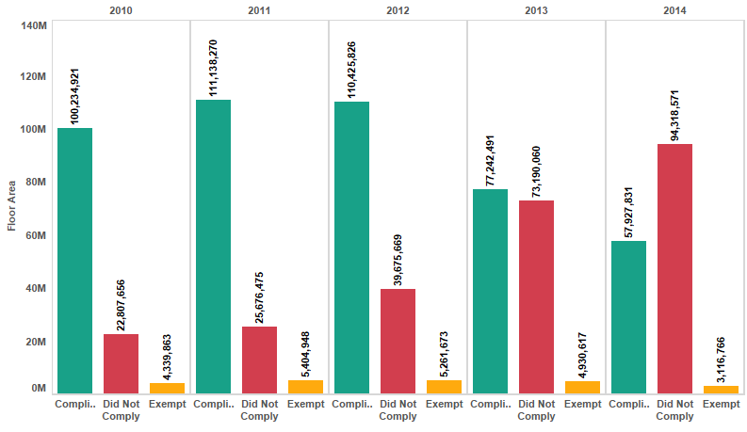
COMPLIANCE Floor Area Y/Y

Slide 4

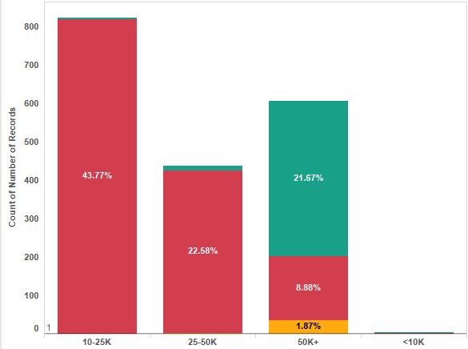
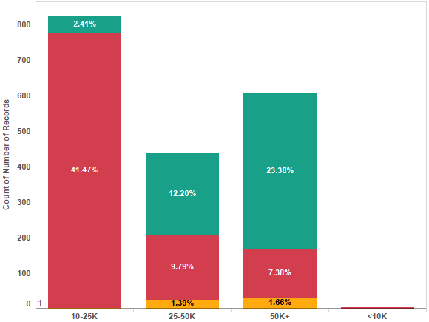
MORE COMPLIANCE Building Count/Square Foot Group
2010
2011

Slide 5
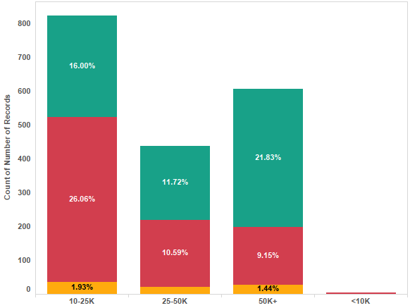
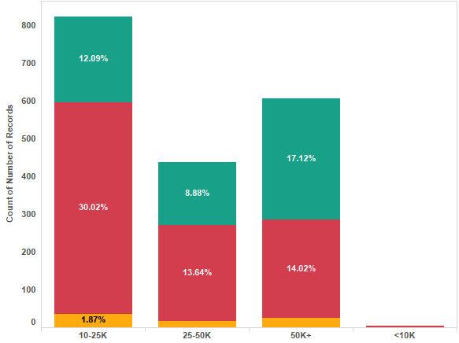
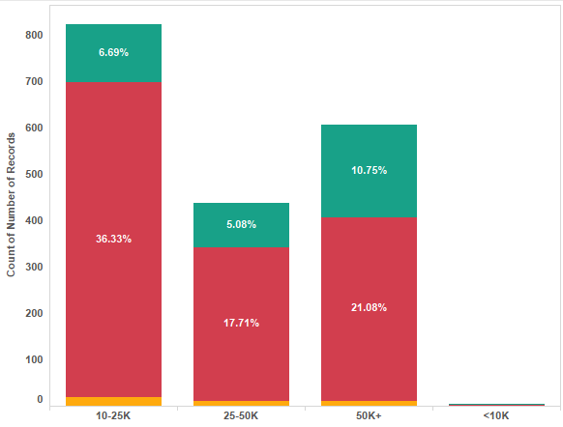
MORE COMPLIANCE Building Count/Square Foot Group
2012
2013
2014

Slide 6
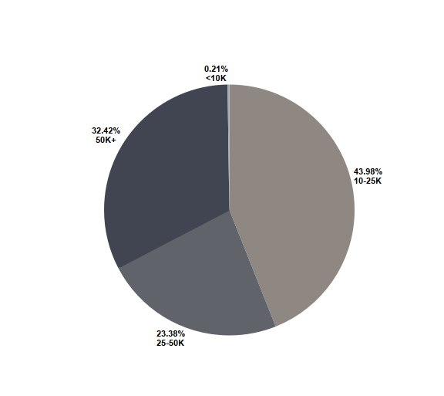
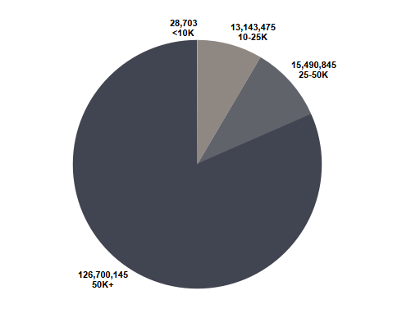

SQUARE FOOTAGE Building Count & Floor Area

Slide 7
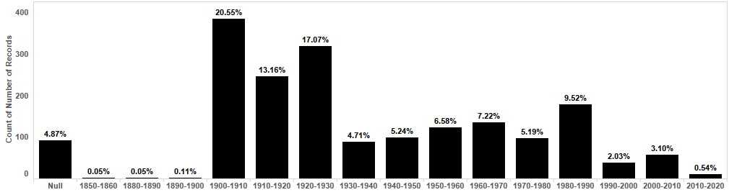
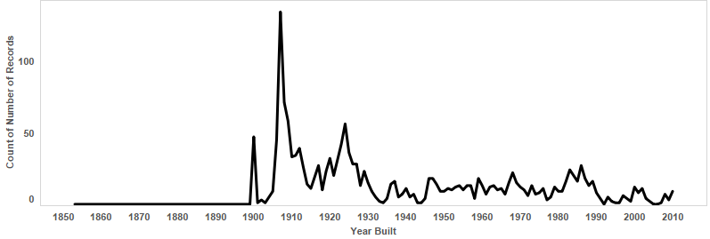
YEAR BUILT GROUP Building Count

Slide 8
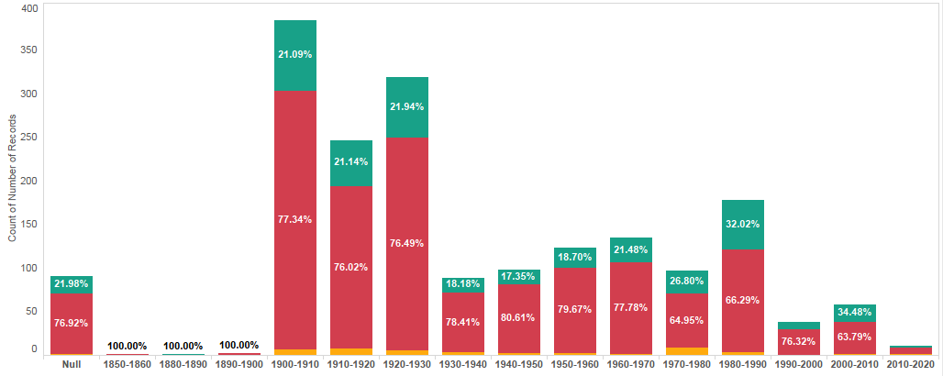
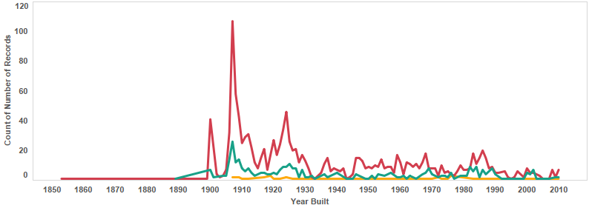
YEAR BUILT GROUP COMPLIANCE Building Count

Slide 9
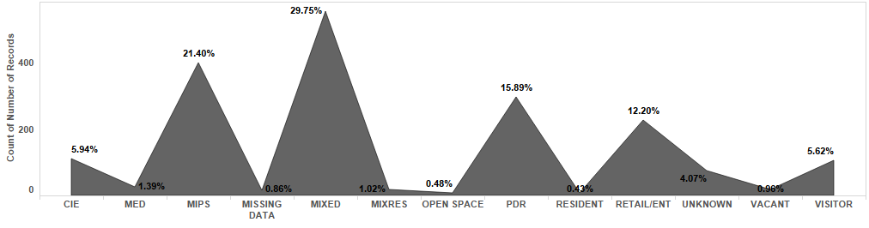
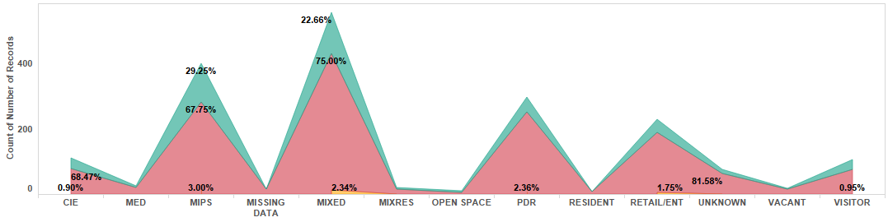

LAND USE Building Count

Slide 10
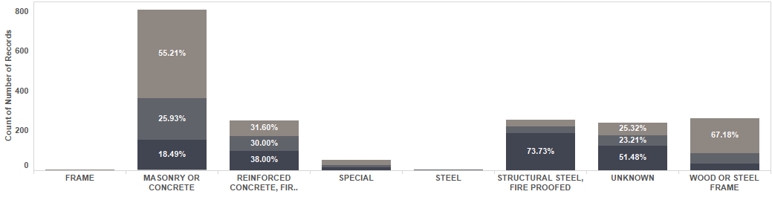
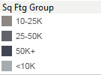
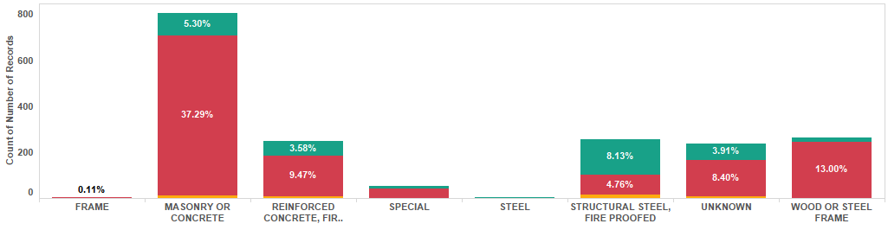

CONSTRUCTION TYPE SqFt Breakdown/Building Count

